Slide 1
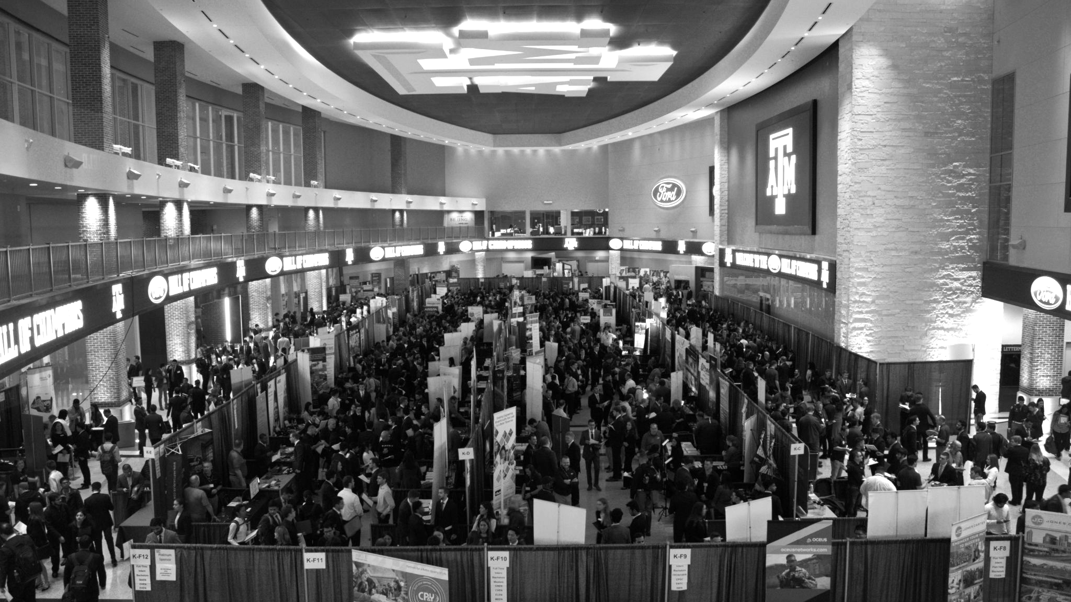

LANL Team Project Update
2/12/2025
Izzy Baumler, Dalton Boeckmann, Morgan Gullo, Jade Waldron

Slide 2
Problem Statement/Project Motivation
There is a need for a technology that has 5 DOF and can move through its full range of motion in each degree of freedom of at least 1 Hz.

Slide 3
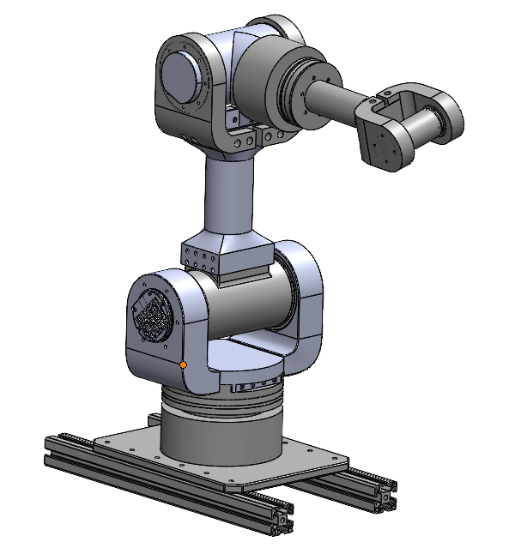
Weekly Assigned Tasks
Jade - Solidworks Refinement/Prototyping/Assembly
Izzy - Motor Research and testing
Dalton - Fastener BOM/Assembly
Morgan - Purchase Orders/Electrical

Slide 4
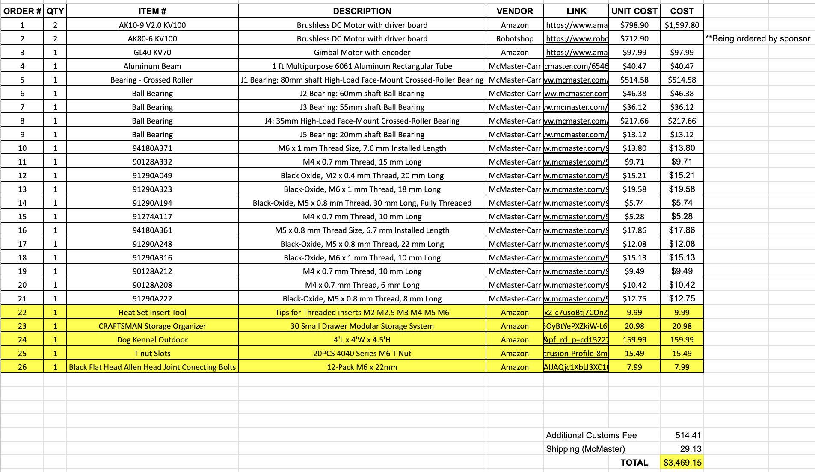
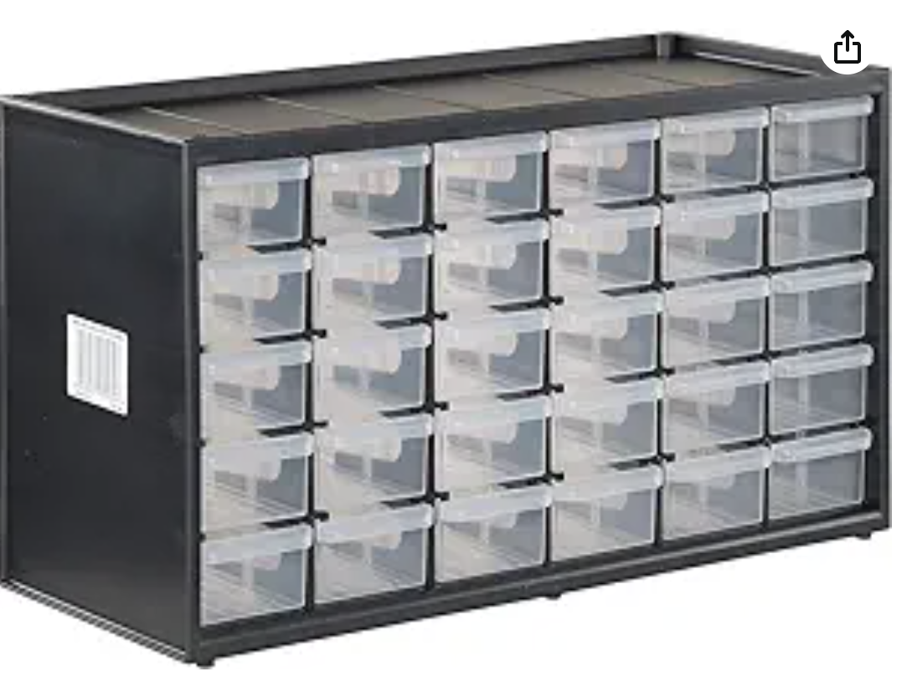
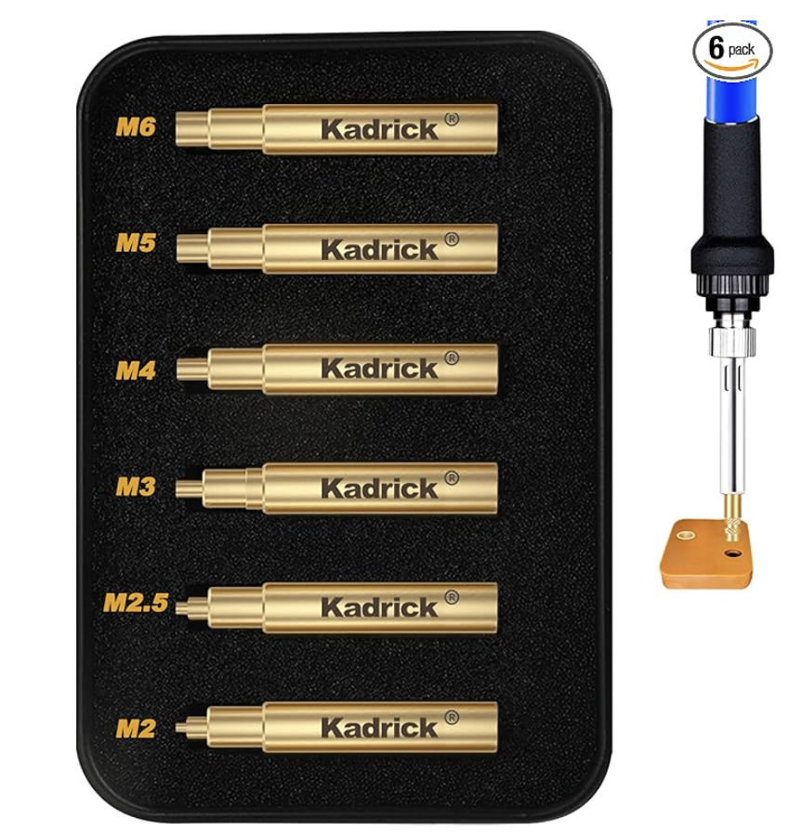
Budget Update

Slide 5
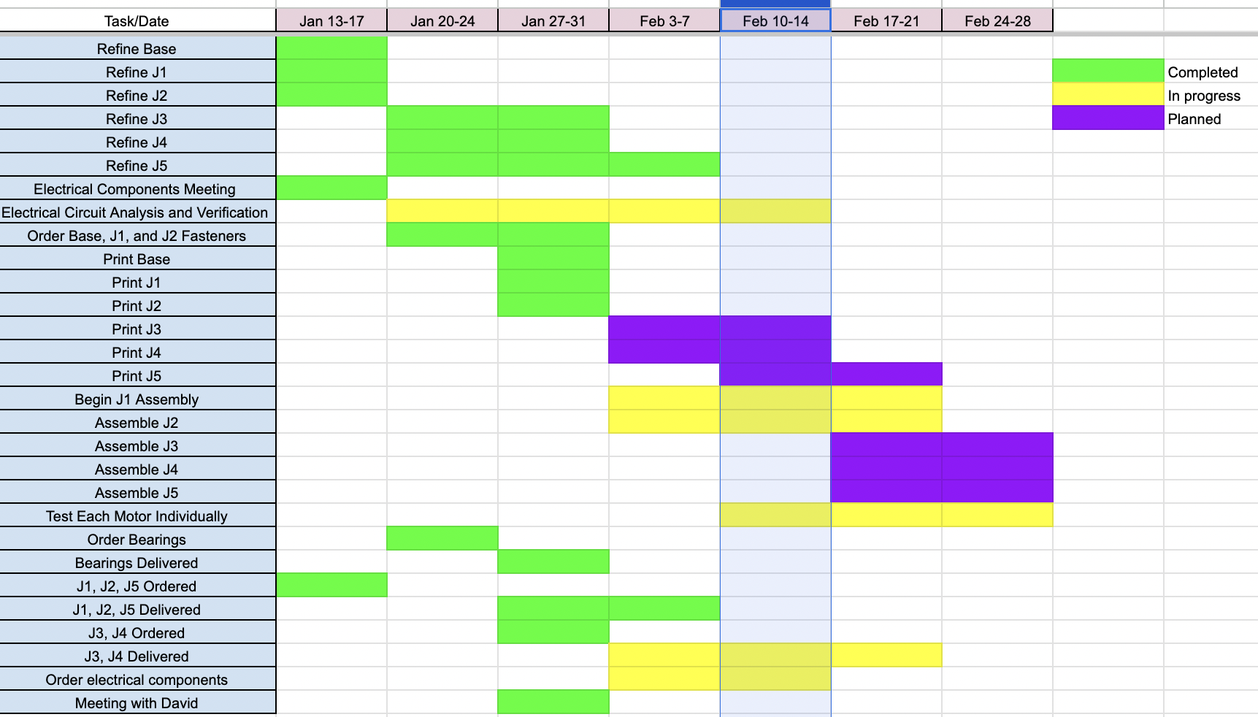
Schedule Update

Slide 6
Fasteners
Base Fasteners (J1-J4): Verification complete.
J5 Fastener: Verification in progress.
All Verified Fasteners: Meet length & size requirements.
Prototyping: Confirms strength & durability.
Drill Bit Set: Seeking recommendations for a set compatible with Allen wrench end tools, suitable for reaching into longer parts.

Slide 7
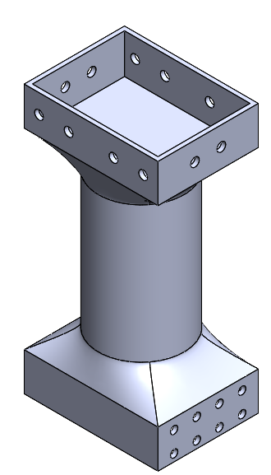
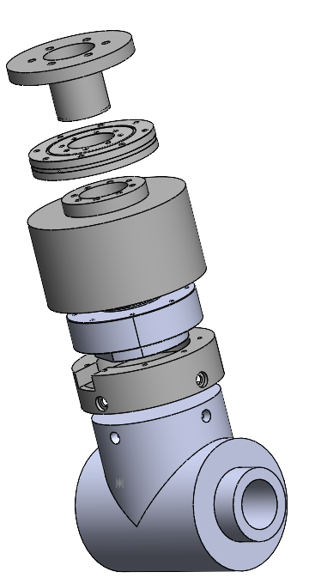
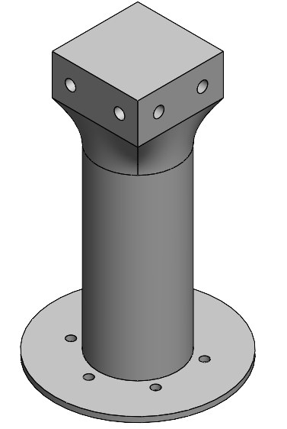
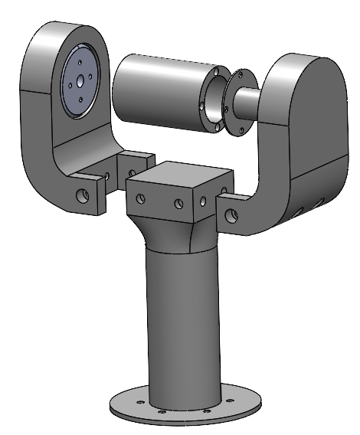
CAD Refinement

Slide 8
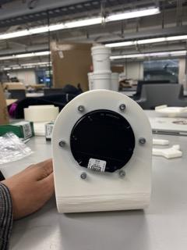
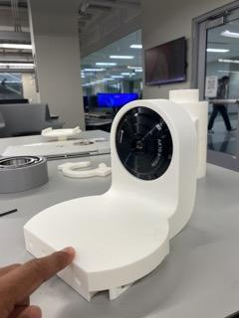
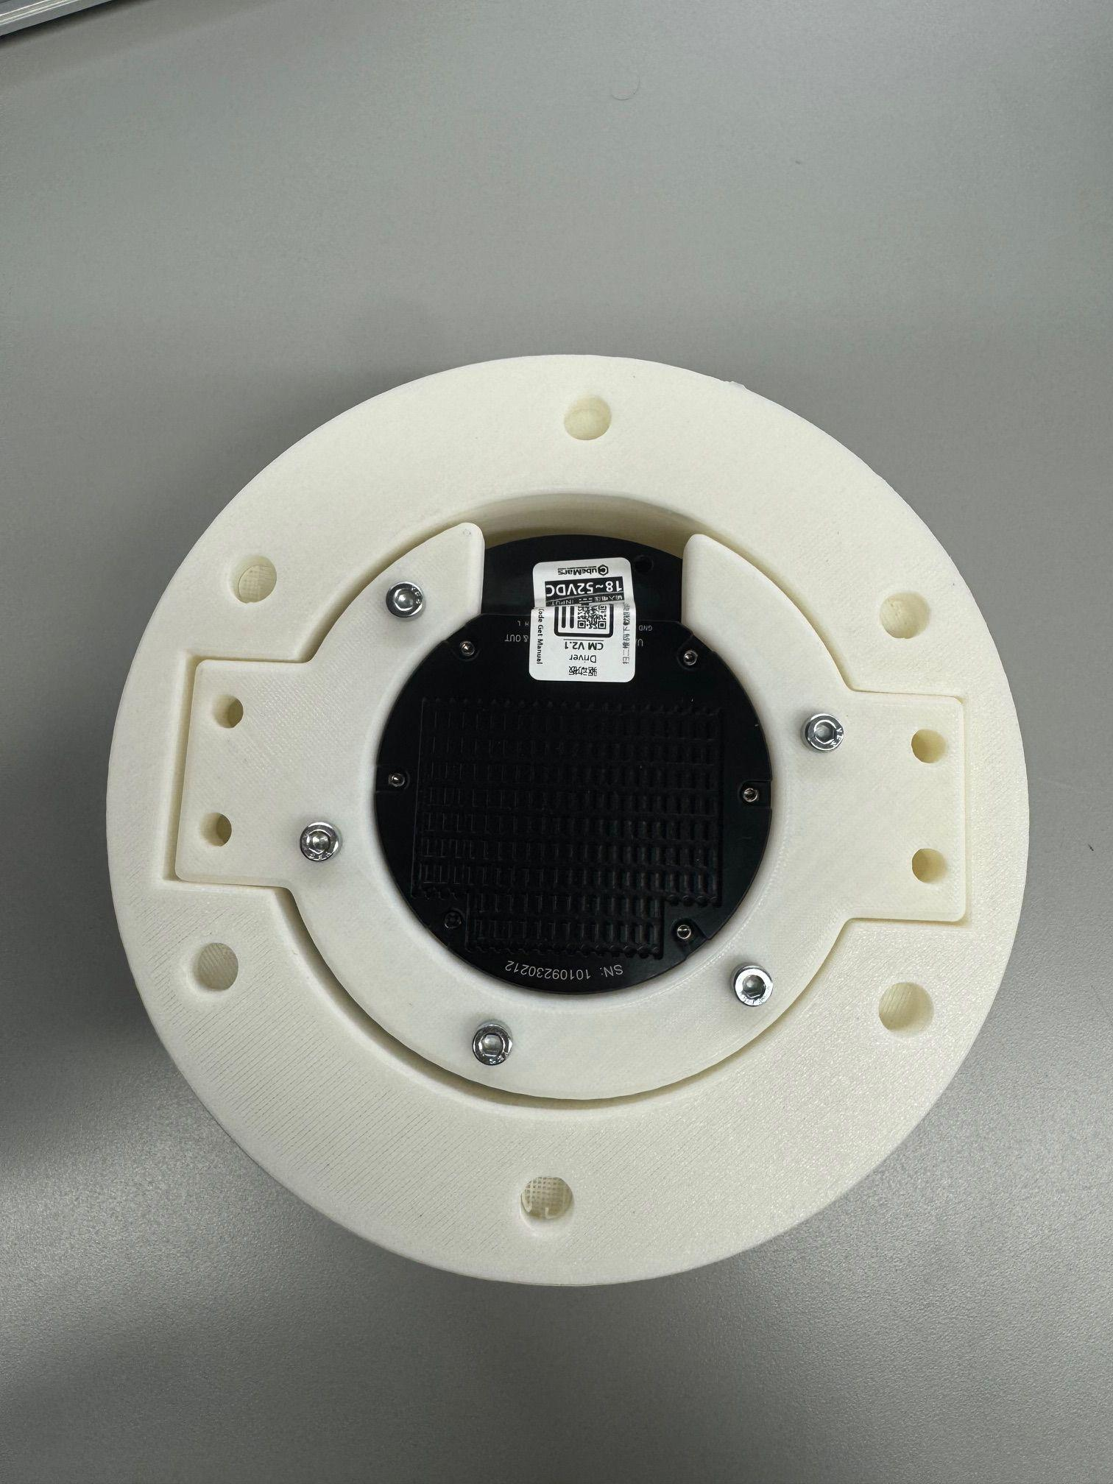
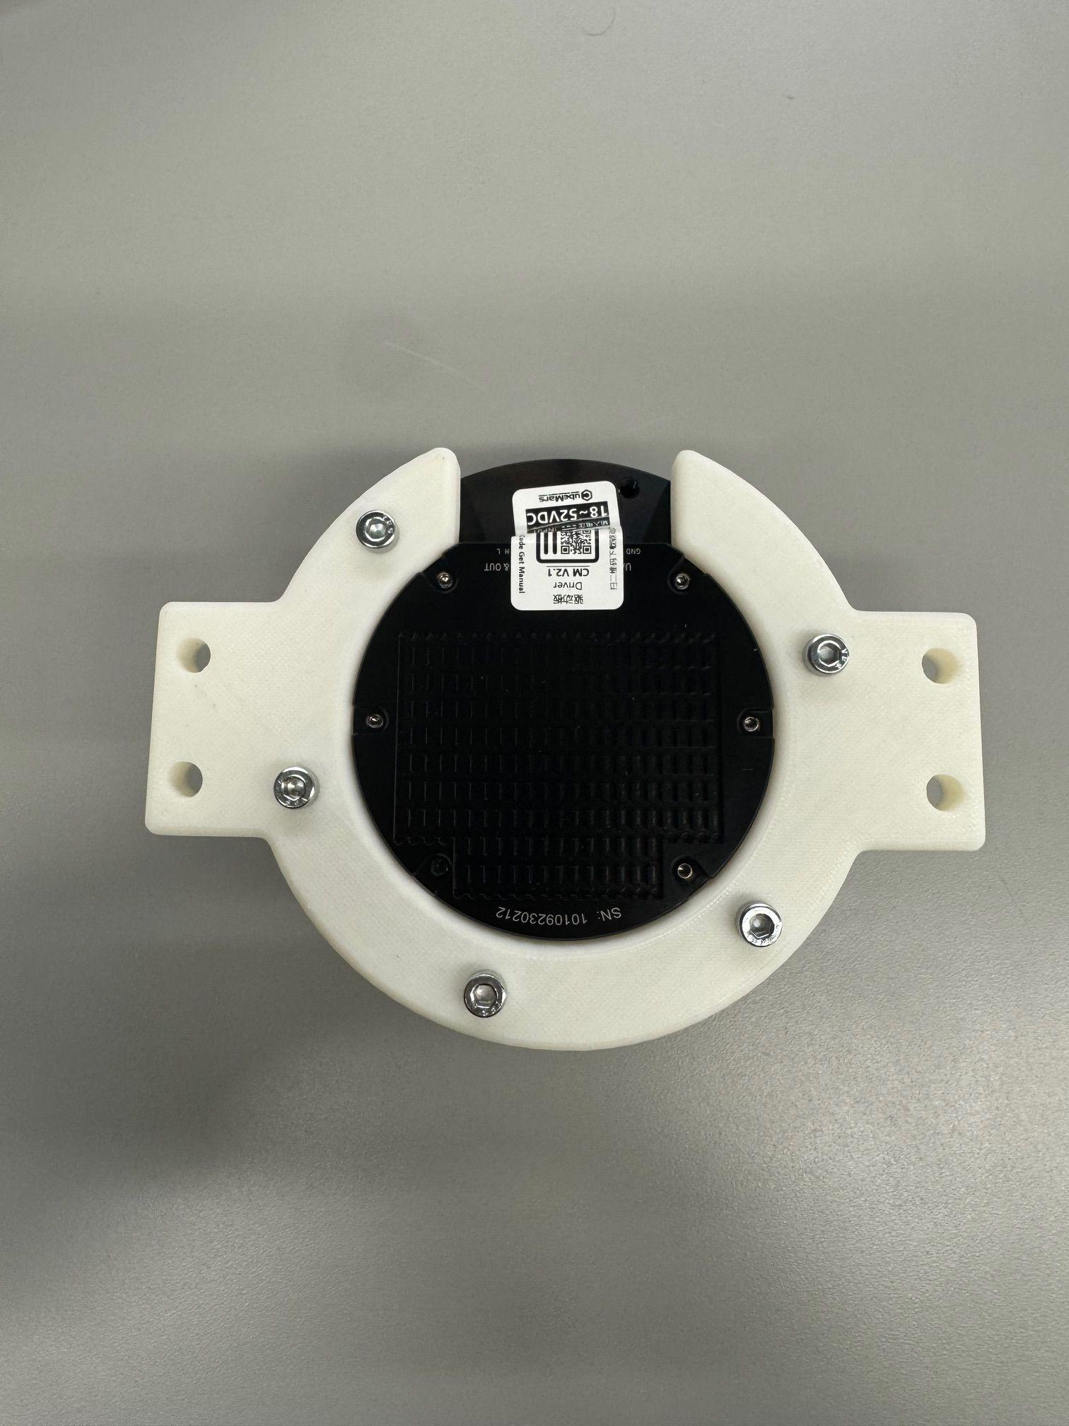
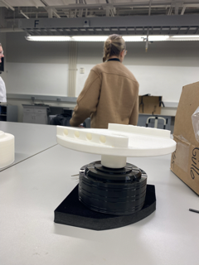
Prototyping/Assembly

Slide 9
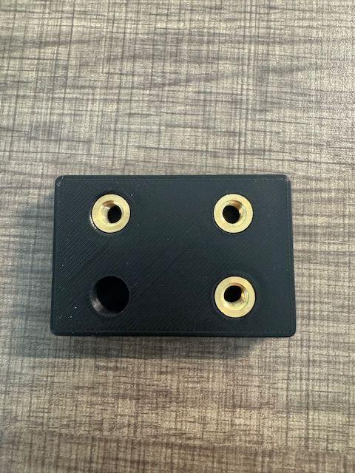
Prototyping / Heat set Insert Test
OD Heat set insert is 9.52
OD hole is 9.32
Made Heat set insert holes even smaller after this test
Ordered our own Soldering Heat set Insert tips (FEDC didn’t have any)

Slide 10
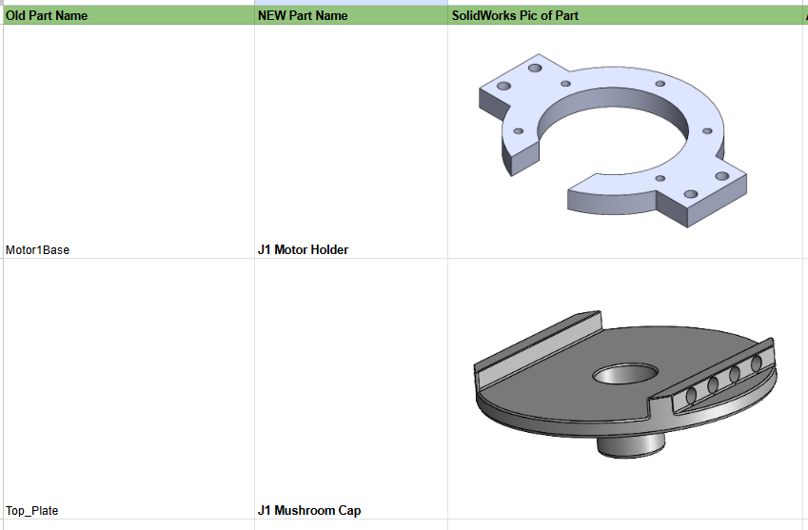
Naming Conventions
Redid Naming Conventions for every SLDPRT
Too much similarity between names

Slide 11
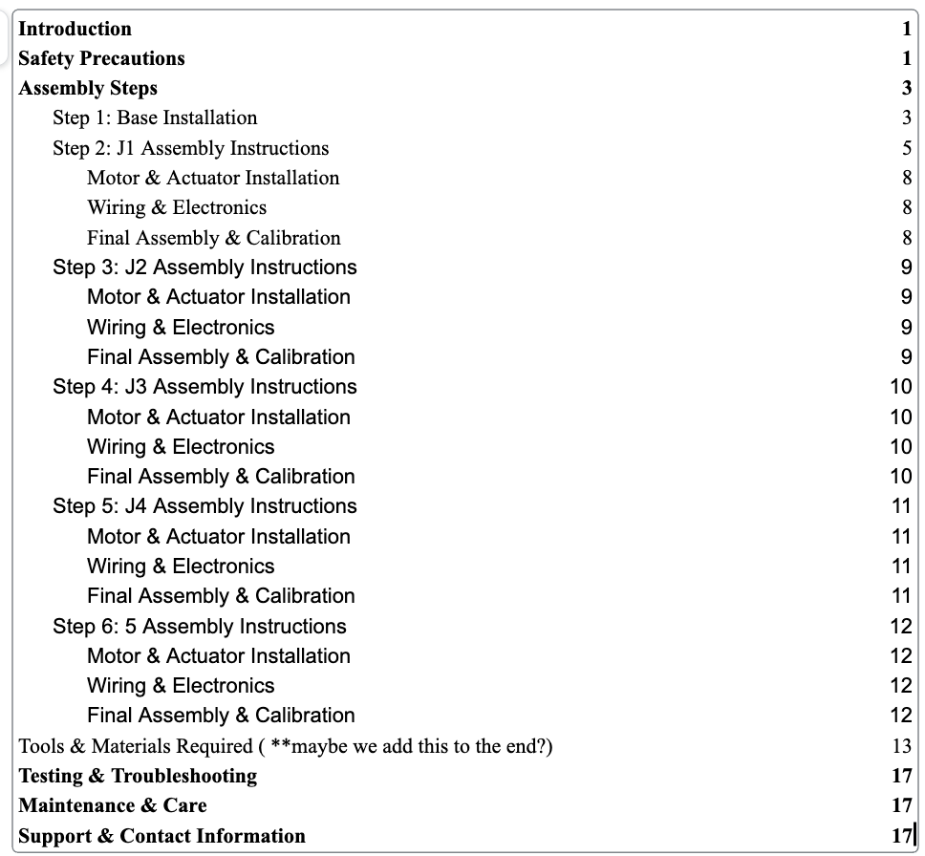
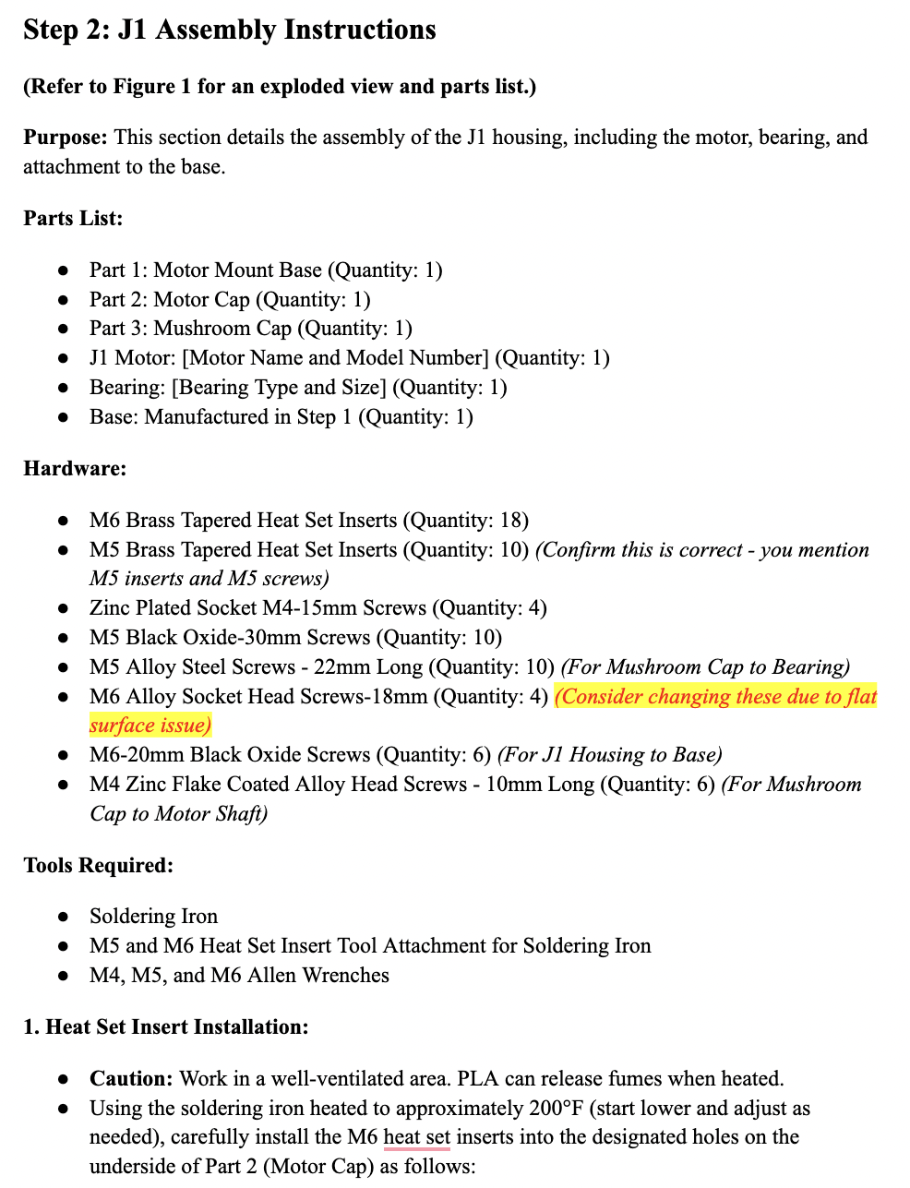
Assembly Manual

Slide 12
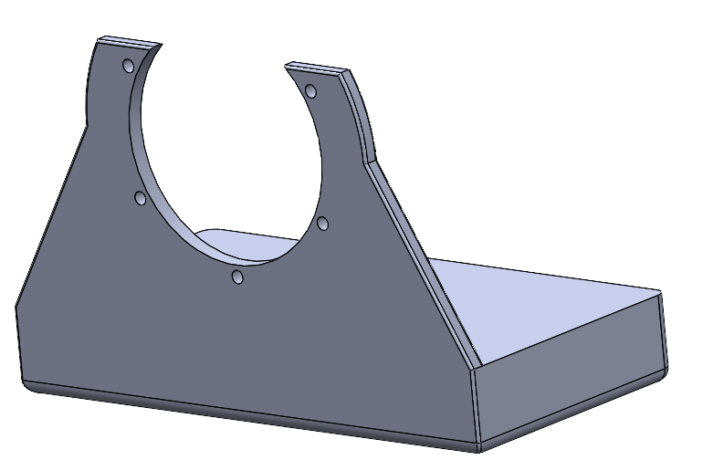
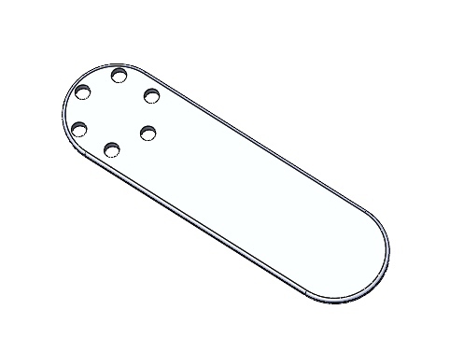
Motor Holder Prototype
Motor Testing: Collaborated with team to identify prototype needs for individual motor testing.
Motor Prototype: Designed and fabricated a motor holder and arm to verify motor rotation.

Slide 13
Motor Research/Testing
Power Supply
Motor
Computer
Arduino
CAN Bus

Slide 14
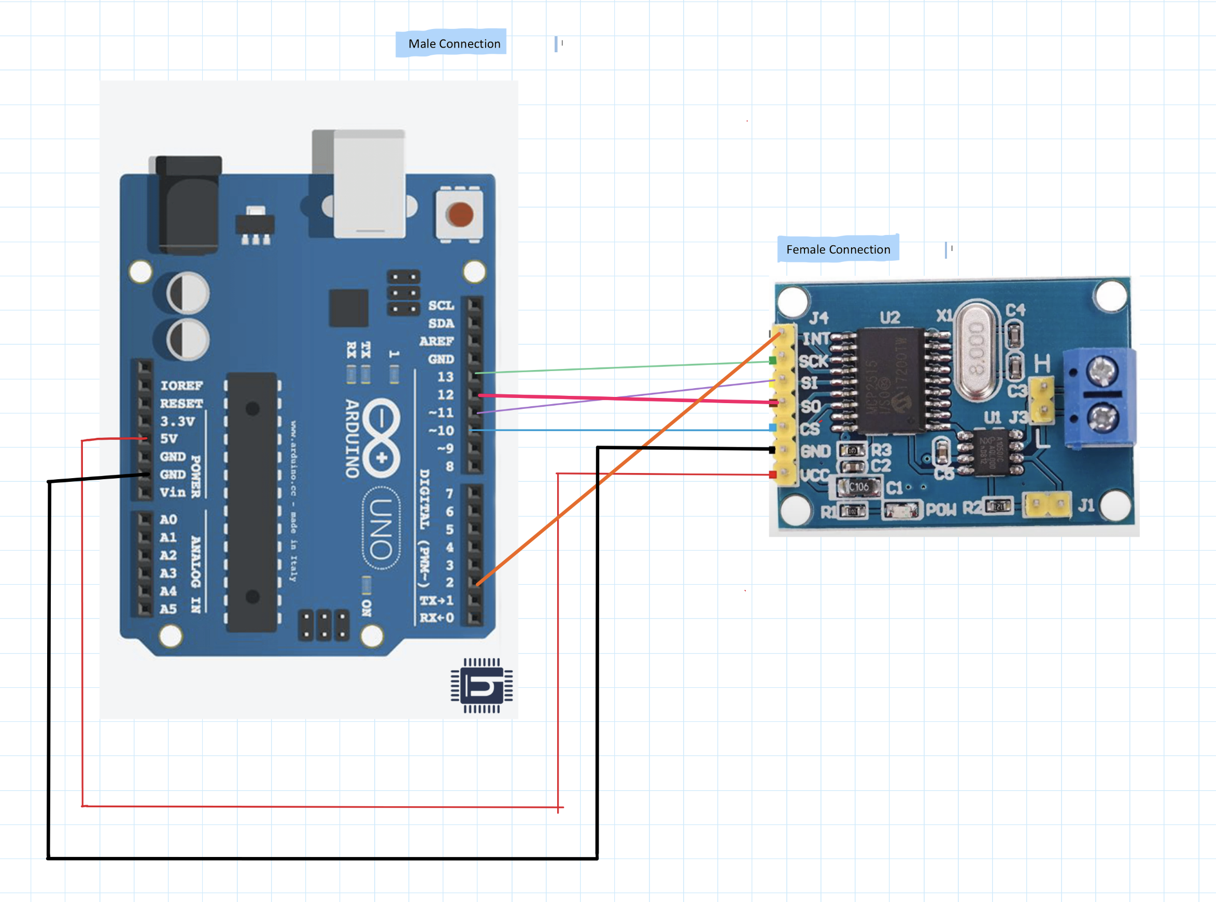
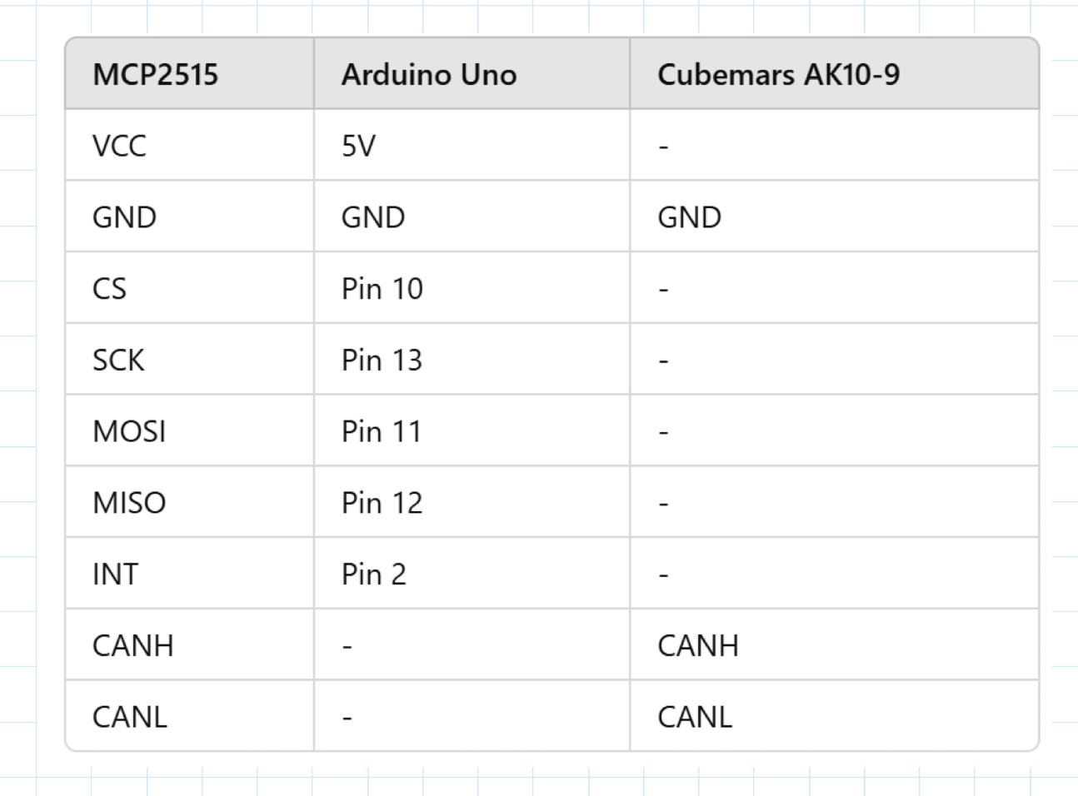
Motor Research/Testing

Slide 15
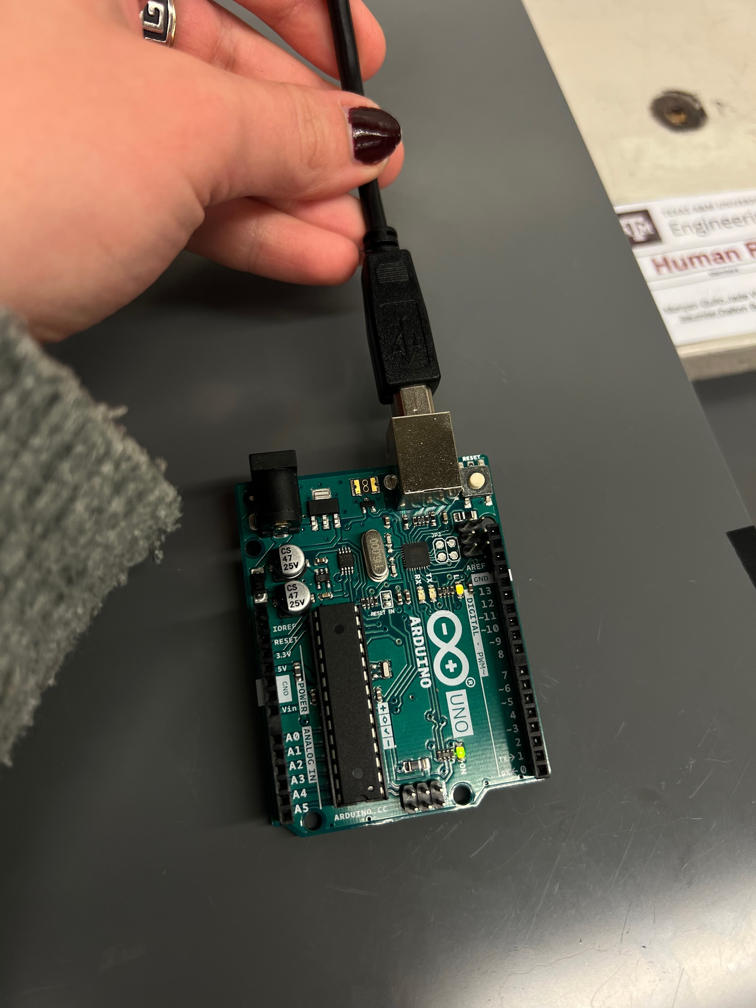
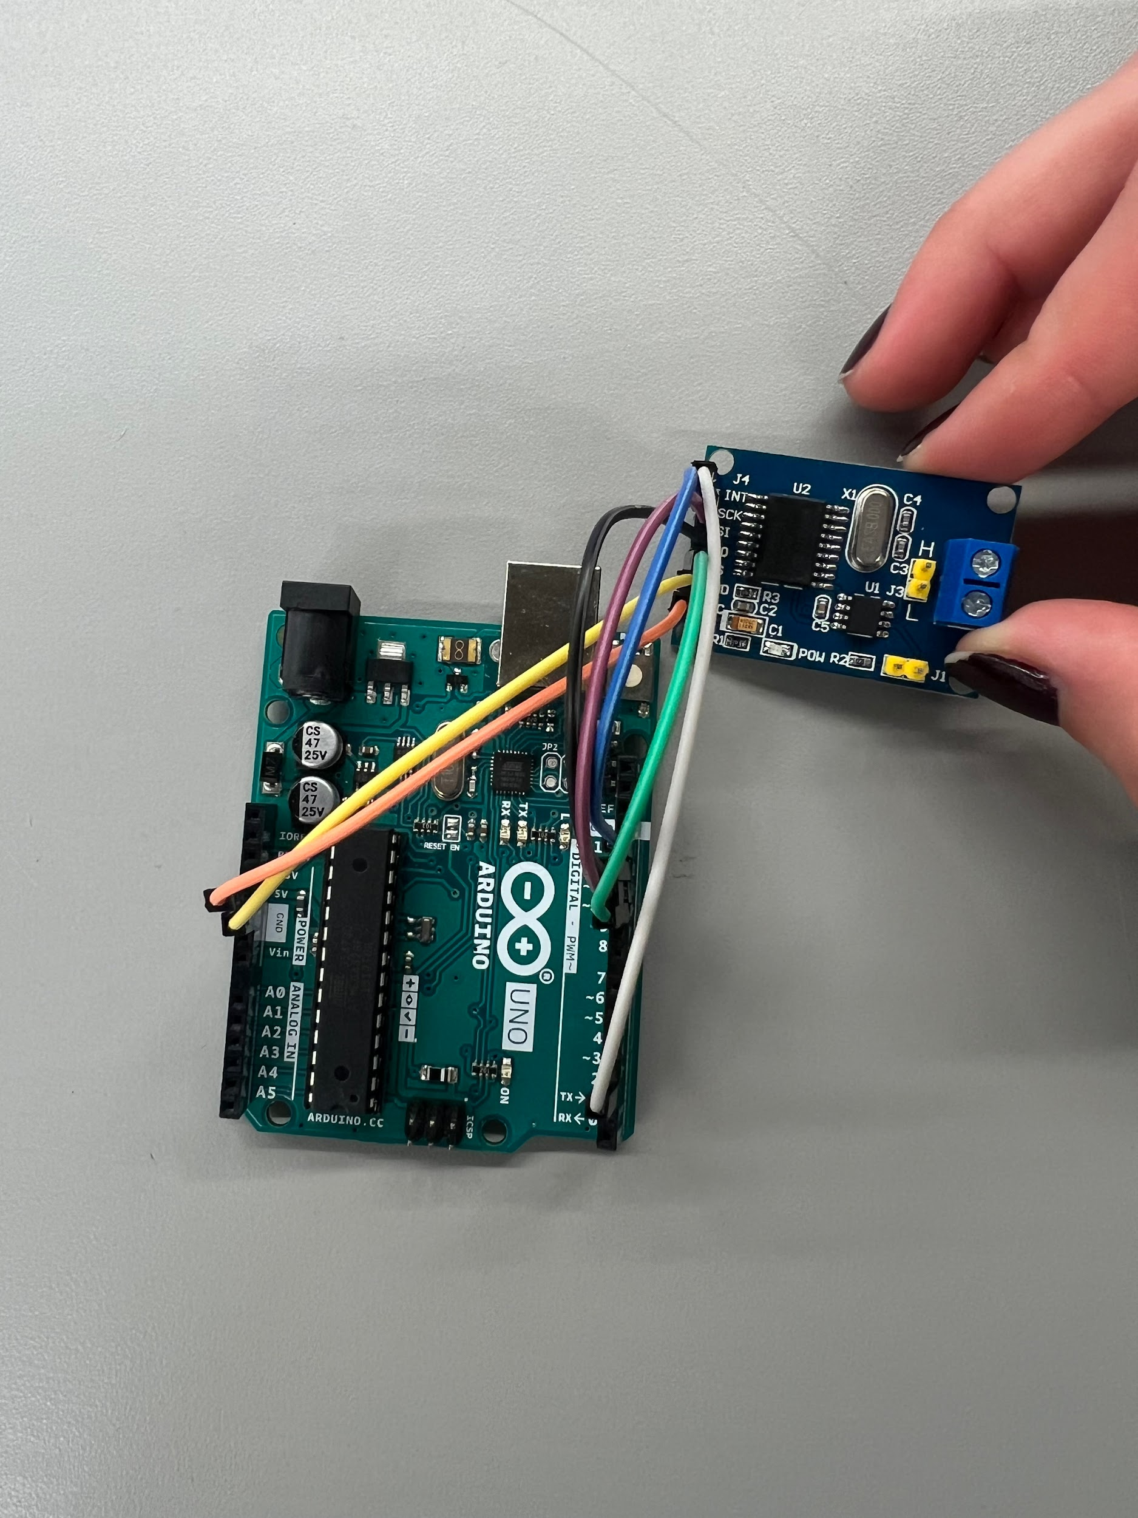
Motor Research/Testing
Verified Arduino works
Next step is testing CAN Bus to Arduino connection
Working on code to control motor

Slide 16
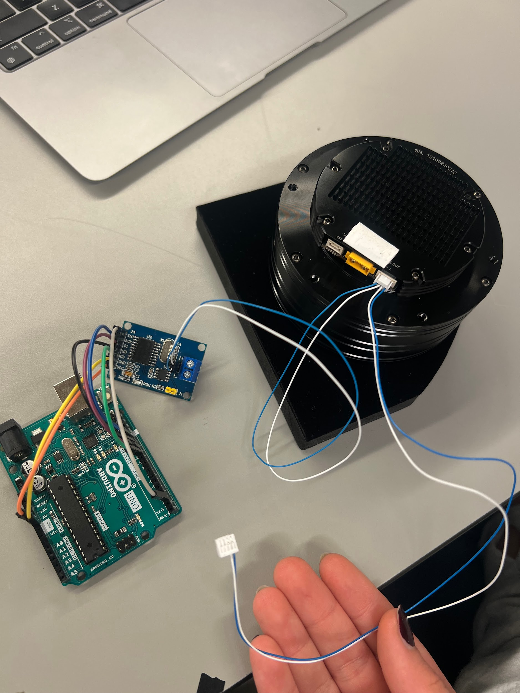
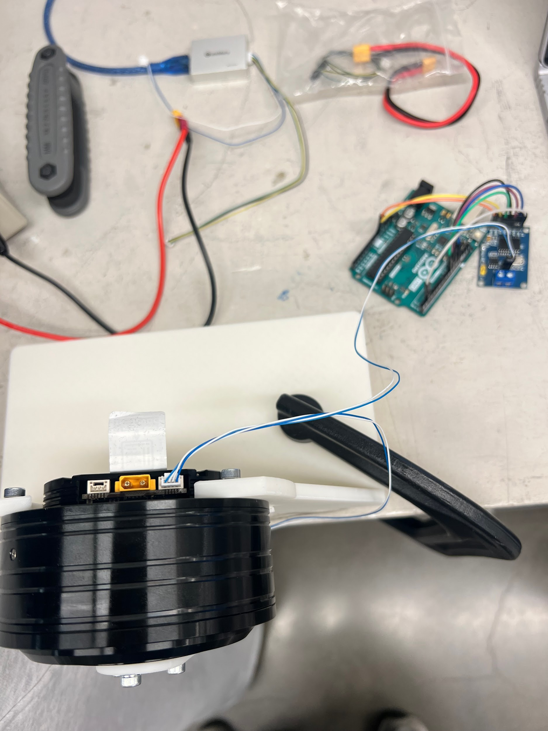
Motor Controls
Working on Can Bus MCP2515 to Arduino Uno Connection
Reaching out to Professor Gray Thomas for help
Confirmed motor and Arduino operate correctly so next step is to troubleshoot the Can Bus

Slide 17
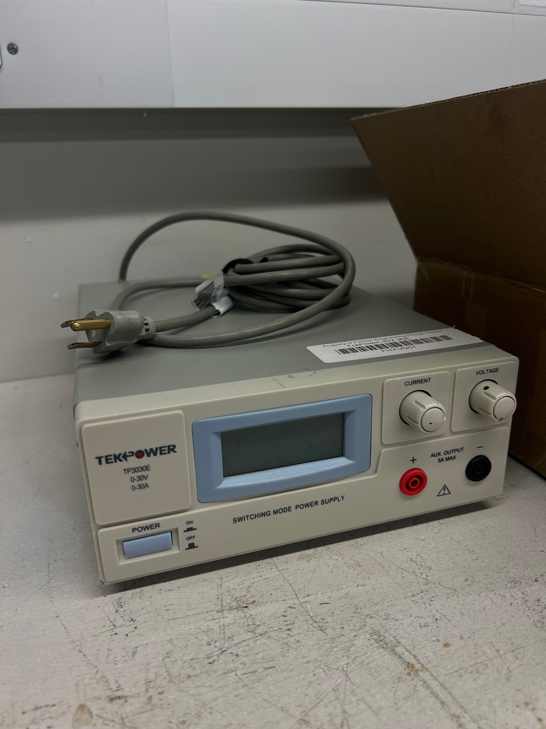
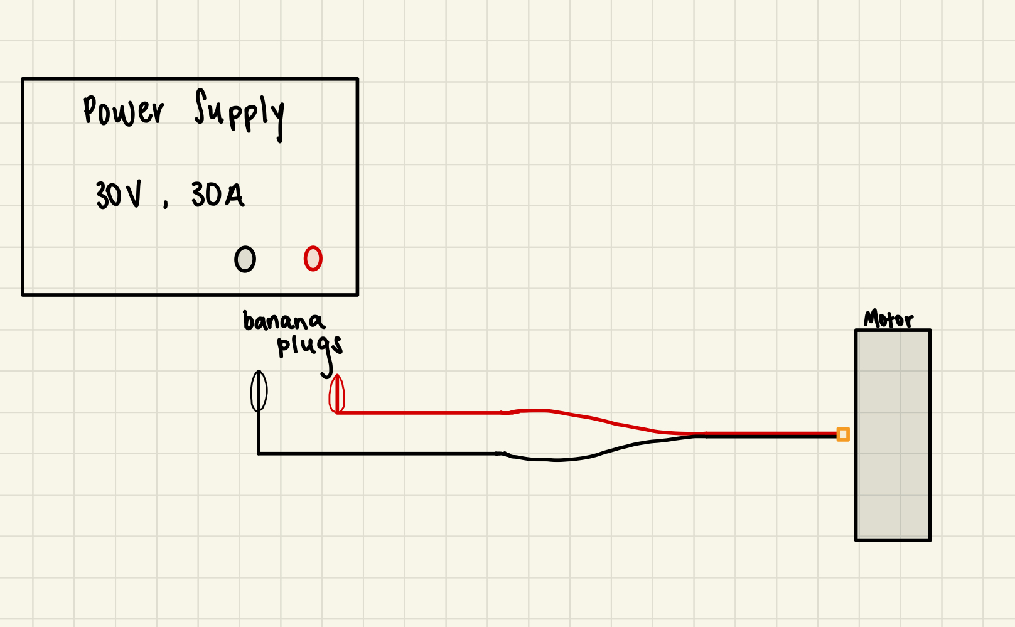
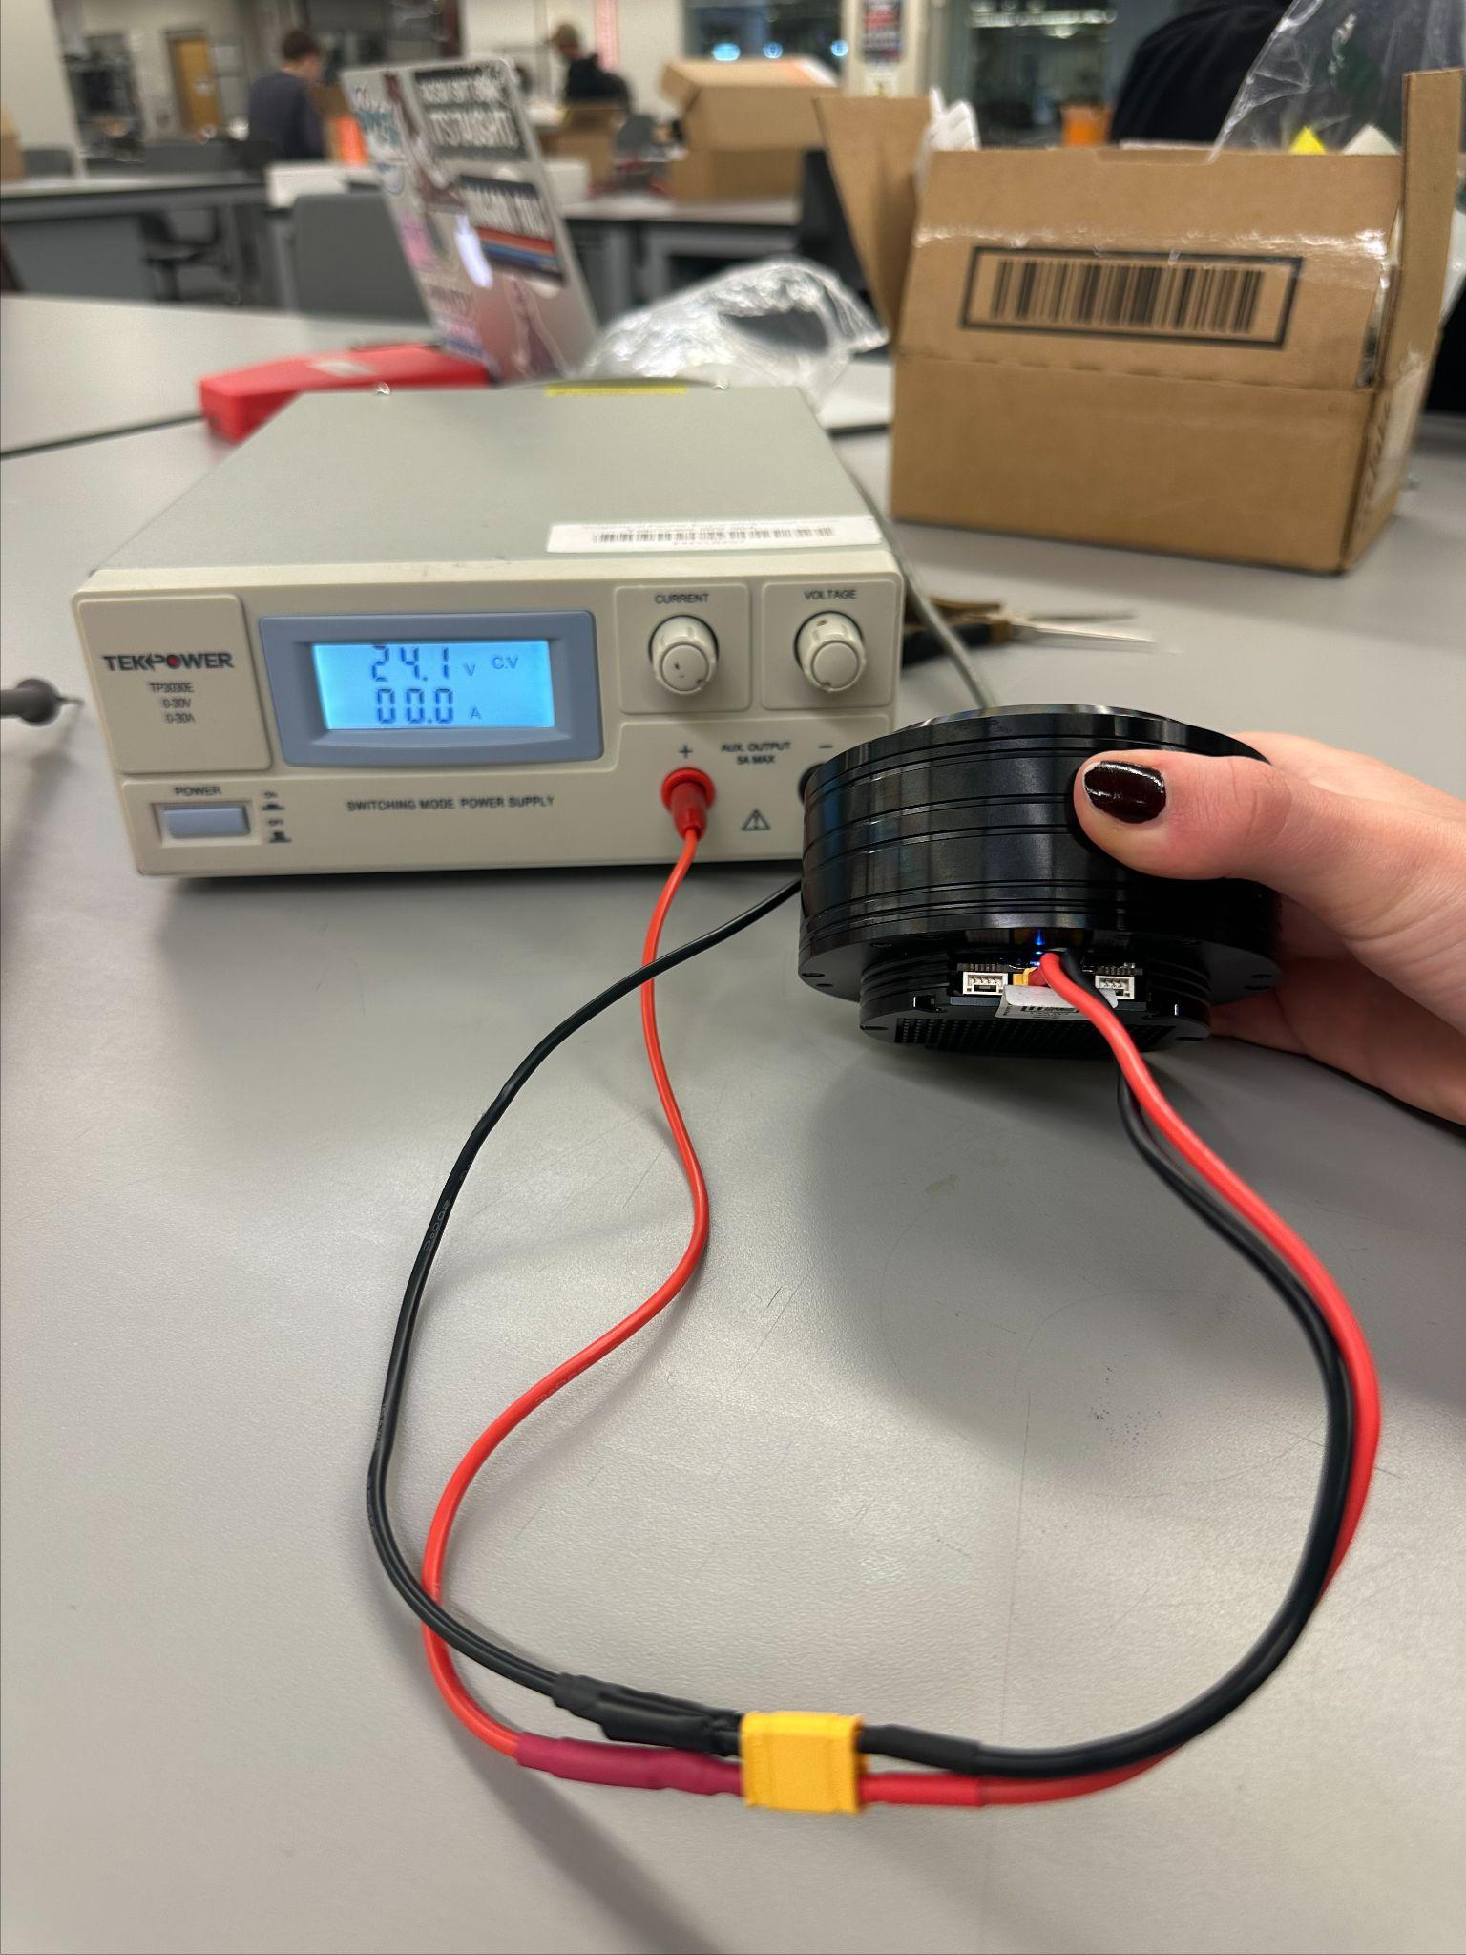
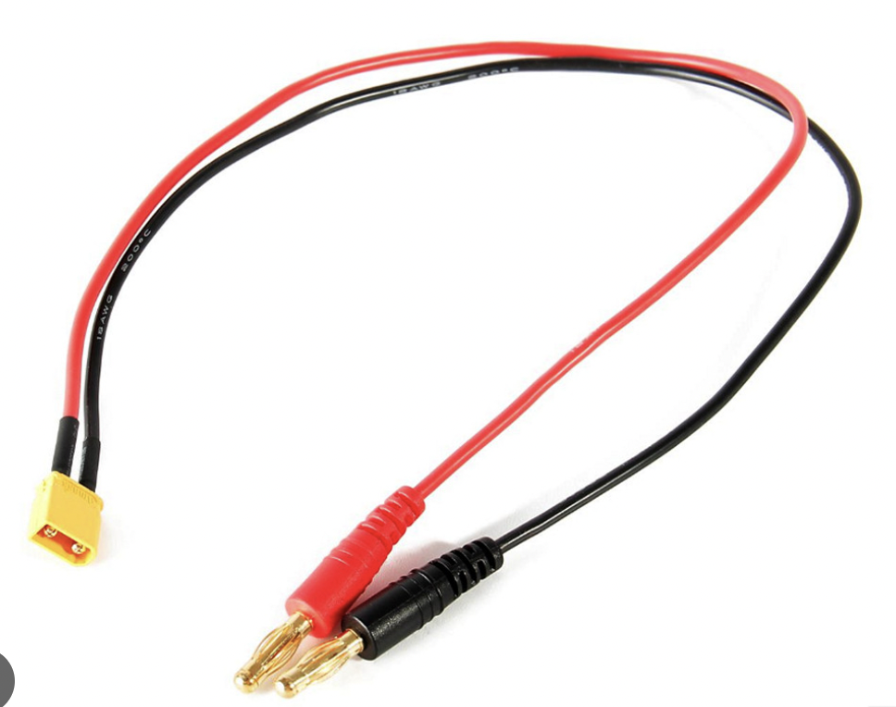
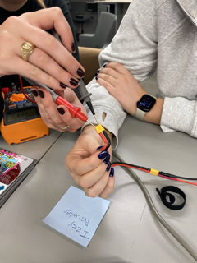
Motor Research/Testing
Preliminary Electrical Testing Setup

Slide 18
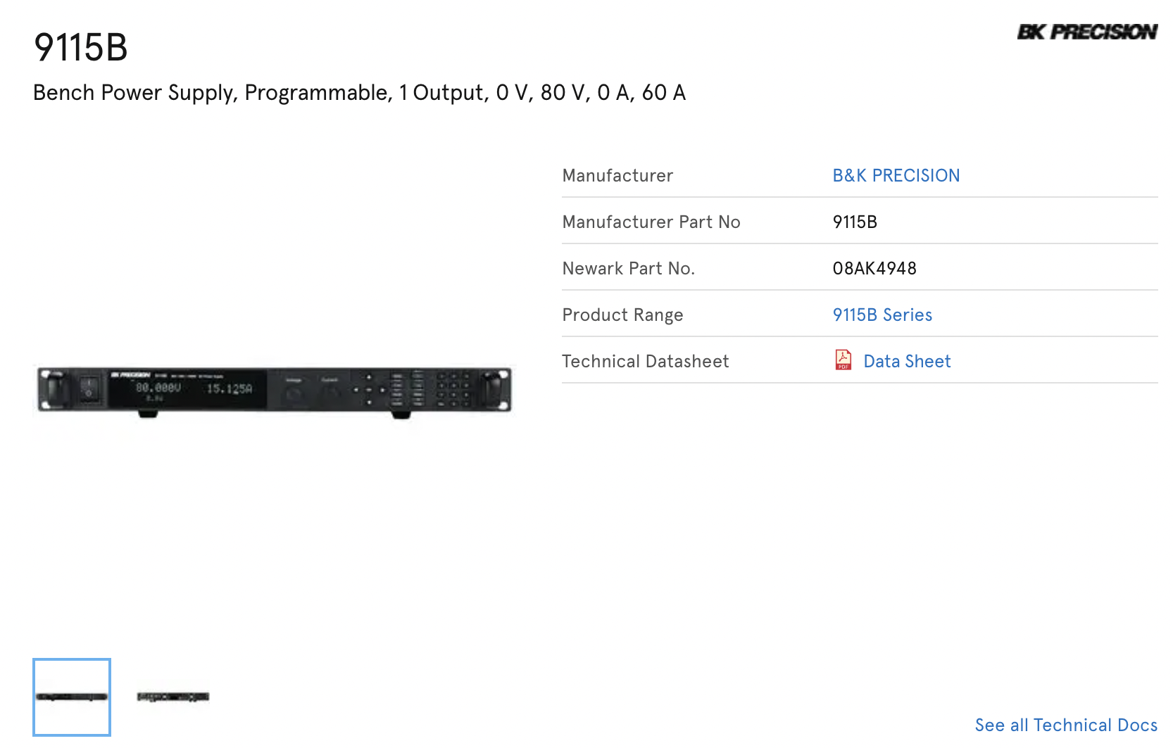
Motor Research/Testing

Slide 19
Future Work
Order/Verify electrical components
Continue assembling Base, J1, and J2
Print J3, J4, and J5
Connect CAN Bus to motors
Connect power supply and test
Continue Assembly Manual
Begin midterm report/presentation

